Slide 1
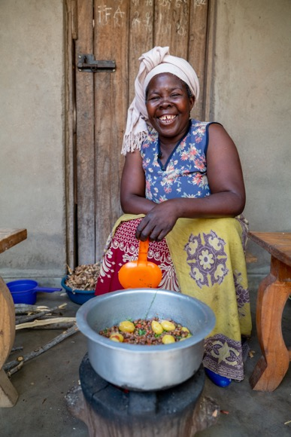
The story of Esther and her pigeon peas
Notes:
Image source - https://massp.ifpri.info/2019/09/13/sourcing-farm-gate-prices-for-pigeon-and-chickpeas-a-pilot-study-in-13-districts-in-southern-malawi/
Food crisis being driven by climate change, war, Covid-19

Slide 2
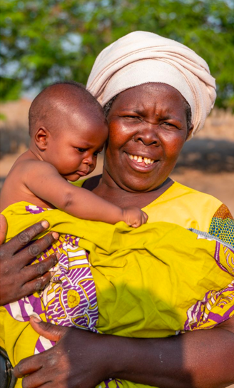
I’d like you to meet Esther Saizi and her wonderful family. This is Esther with her grandson Nespo.
There is something magical about Esther’s warm heart and everyday acts of kindness.

Slide 3
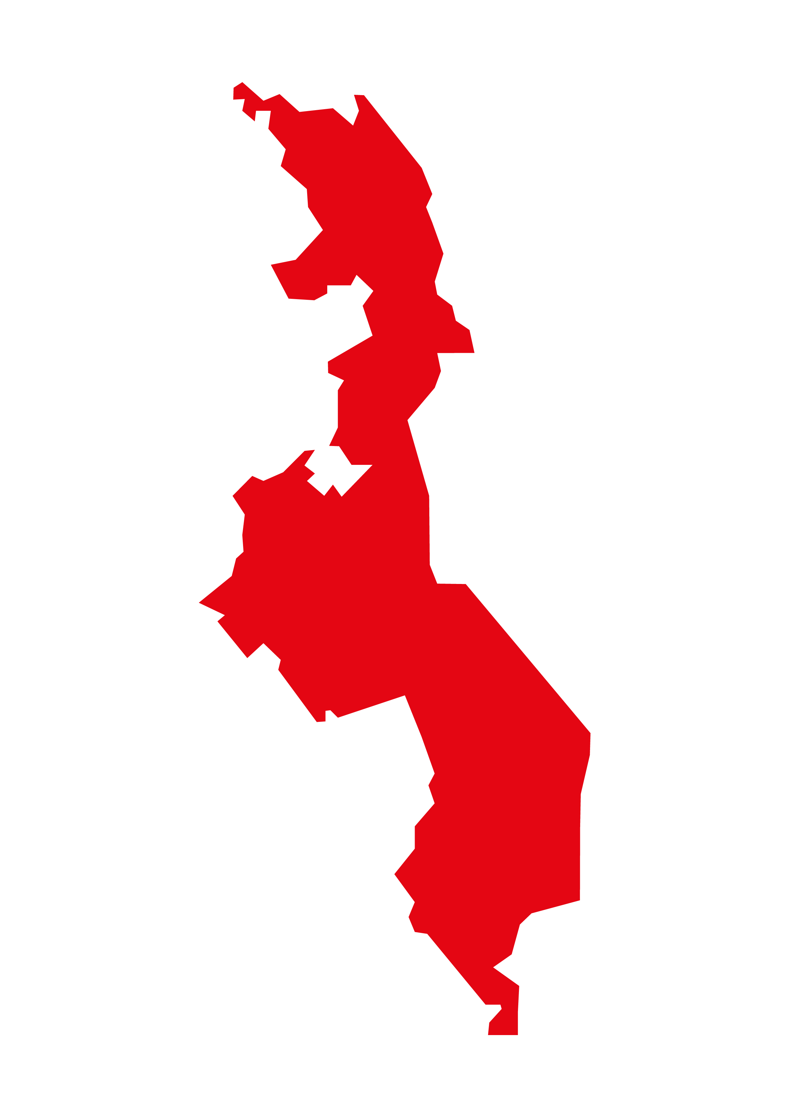
Esther lives in Malawi, which is in the south-east of Africa.
Its people are so friendly that Malawi is sometimes called the ‘Heart of Africa’

Slide 4
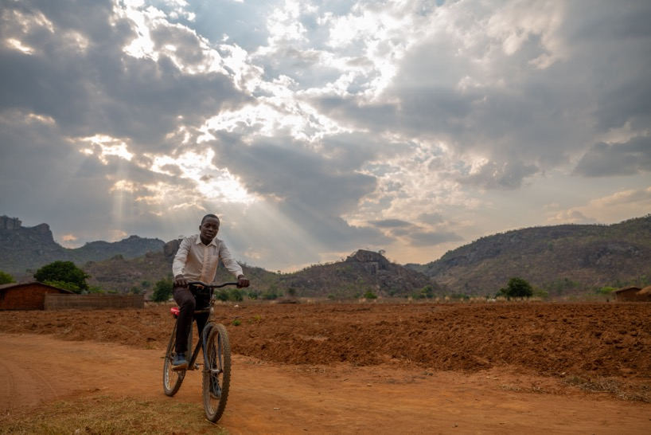
Malawi is a beautiful country of cooler mountains in the north, the shimmering waters of Lake Malawi in the east, and sun-drenched lowlands to the south.

Slide 5
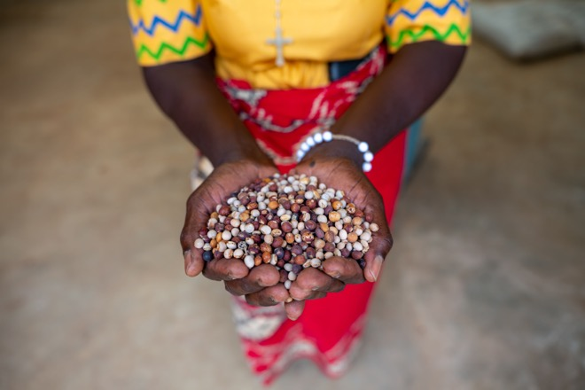
Esther grows something on her farm. Can you guess what it is? What is this story about?
It’s pigeon peas!
But these are no ordinary peas…

Slide 6
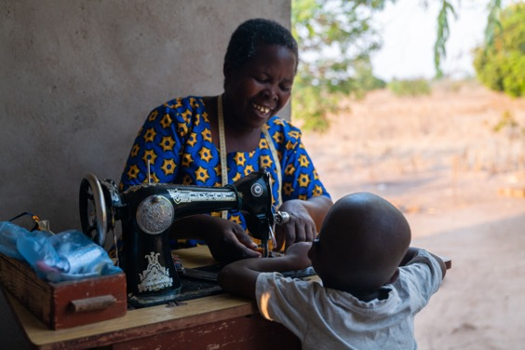
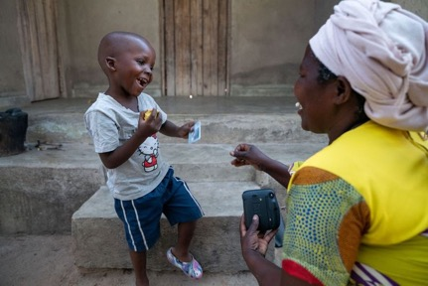
…because with these peas, Esther can bake delicious bread. And that’s not all…
…by selling these pigeon peas, Esther can pay for her grandson to go to nursery and to help her children’s dreams come true.
I bet you didn’t know peas could do all that!

Slide 7

But in Malawi, the costs of everyday essentials, such as food and fuel, are going up and up, just as they are here.
In addition, the climate crisis means it is increasingly difficult to grow many of the foods Esther and her family used to eat and sell.

Slide 8
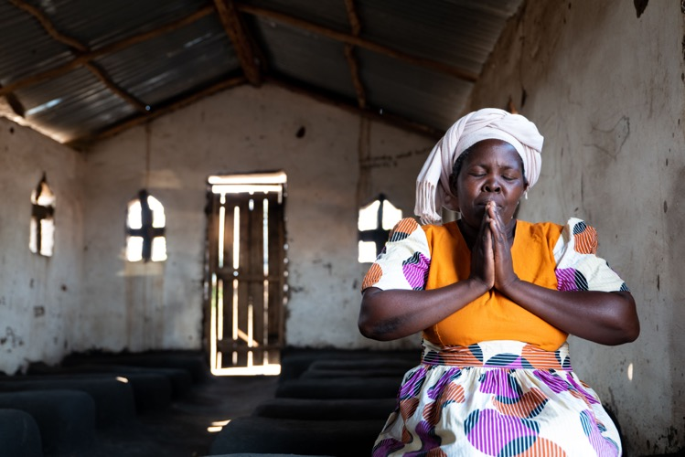
Often crops are lost to cyclones or droughts, or seeds are too old to grow well.
Many farmers like Esther are exploited by big companies and don’t receive a fair price for their peas.

Slide 9
But Esther is working with Christian Aid and others in her community. Together they have:
formed cooperatives to secure a fairer price.
boosted the quality of the seeds they use.
added value by baking and selling bread made from pea flour.
built warehouses to keep peas safe from weather events
even produced a pigeon pea recipe book!

Slide 10
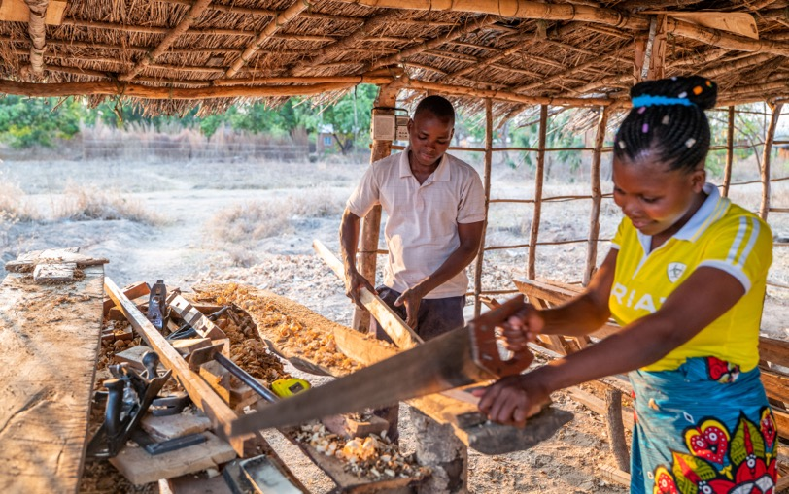
Esther says: ‘We are a community that helps one another a lot… if people face a problem, we do not allow them to suffer alone.’
So, when we give to Christian Aid, we become part of Esther’s community of people who help one another and help make dreams come true.

Slide 11
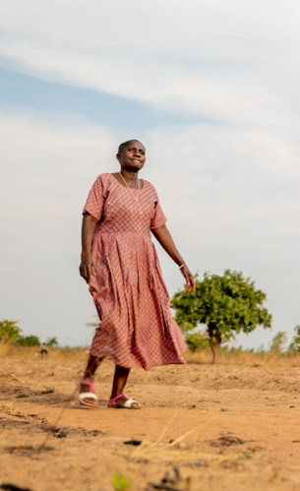
In the Bible, Jesus tells a story:
‘The kingdom of heaven is like a mustard seed that someone took and sowed in his field; it is the smallest of all the seeds, but when it has grown it is the greatest of shrubs and becomes a tree, so that the birds of the air come and make nests in its branches.’
(Matthew 13:31-32)

Slide 12
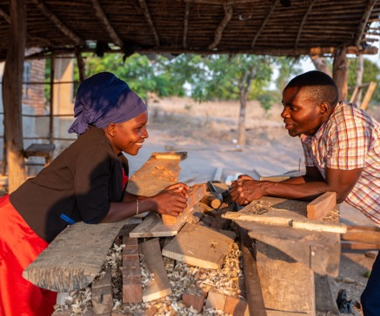
For Esther and her community, pigeon peas are like the tiny mustard seed, growing the hopes and dreams of their children and grandchildren:
to go to school.
to start their own businesses.
to help their friends and their neighbours.
Together, we can help dreams come true

